Slide 1
Lesson 5.3
Web Security Overview

Slide 2
Learning Outcomes
Explain different web security concerns
Use any of web security technologies and techniques

Slide 3
Web Security

Slide 4
Security Vulnerabilities
Vulnerabilities are flaws in code that, when exploited by hackers, can lead to:
Private data being stolen
Code tampering
Complete data loss
The types of vulnerabilities you’ll encounter varies depending on the framework and programming language you are using.
Today we will discuss a short list of common security vulnerabilities and how to protect against them.

Slide 5
SQL Injection
WHAT: Structured Query Language (SQL) injection is an attack by a bad actor that attempts to insert harmful logic into your SQL statements through user input fields (e.g. text fields). A hacker can send a malicious SQL command directly to a website’s database.
WHY: Occurs when the website is not performing input field sanitization correctly, or not performing it at all. The website offers a direct link from the front-end through the back-end to the database.
POTENTIAL NEGATIVE OUTCOMES:
Unauthorized data access and modification.
Data loss.
Changes to an application’s content and behavior.

Slide 6
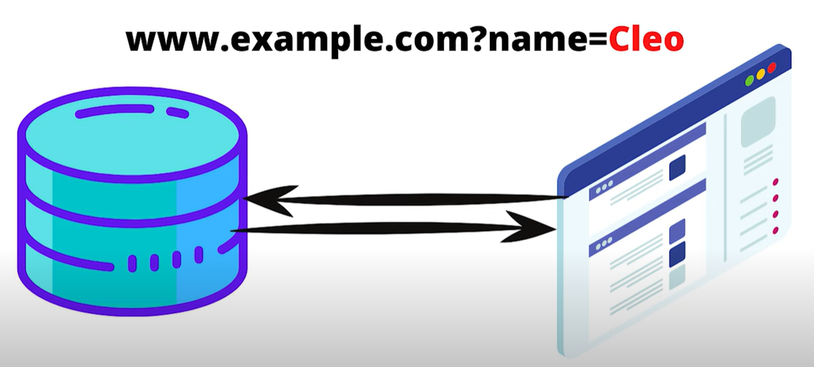
SQL Injection

Slide 7
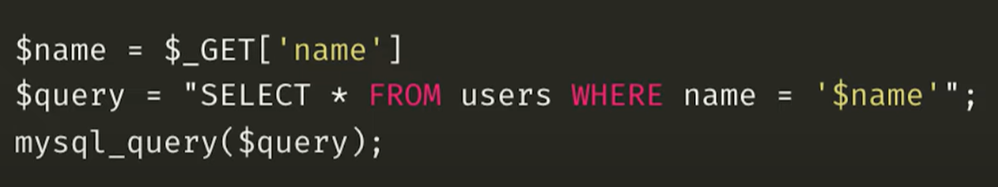
SQL Injection
This example is written in PHP and interacts with a MySQL database.

Slide 8
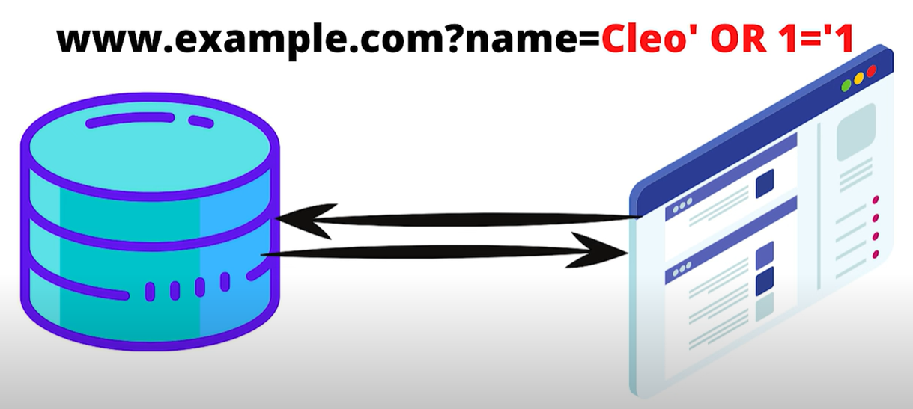
SQL Injection

Slide 9
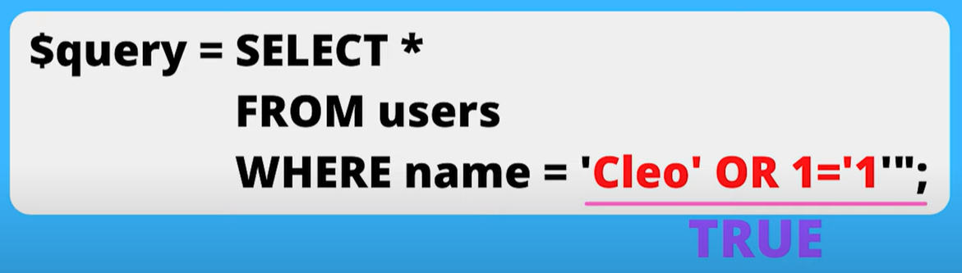
SQL Injection
This query will return ALL users and their data from the database.

Slide 10
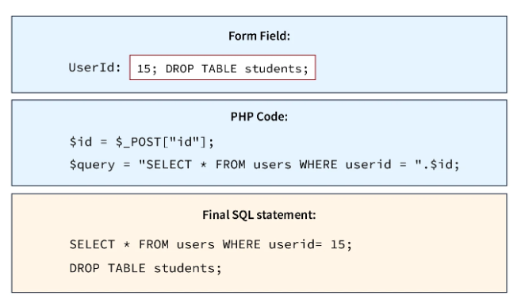
SQL Injection
This query will drop (delete) the “students” table.

Slide 11
SQL Injection
PREVENTION METHODS:
Input sanitization.
This means to review (and possibly correct) all user inputs before making a database call.
Remove dangerous characters and phrases:
Quotes (‘) (“)
Semicolons (;)
“UNION”
Use prepared statements.
The query we want to execute is provided to the database in advance. Any input is then treated as a parameter and will not be treated as SQL code.

Slide 12
Cross-Site Scripting Attacks (XSS)
WHAT: Cross-Site Scripting (XSS) attacks are a type of web injection attack where a bad actor attempts to inject malicious scripts (usually JavaScript) into a website.
The end user’s browser has no way to know that the script should not be trusted and will execute the script.
WHY: Occurs when a web application uses input from a user without validating or encoding it.
POTENTIAL NEGATIVE OUTCOMES:
Capturing the keystrokes of a user.
Redirecting a user to a malicious website.
Running browser–based exploits (e.g. crashing the browser).
Obtaining the cookie information of a user who is logged into a website, thus compromising the victim’s account.

Slide 13
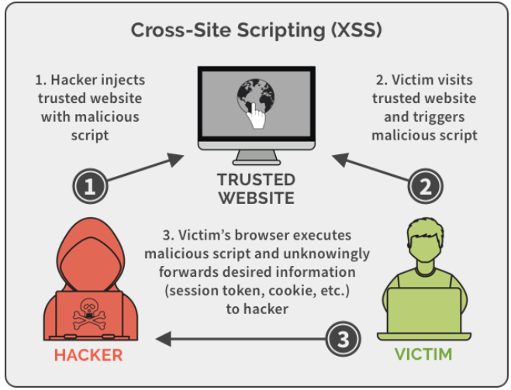

Slide 14
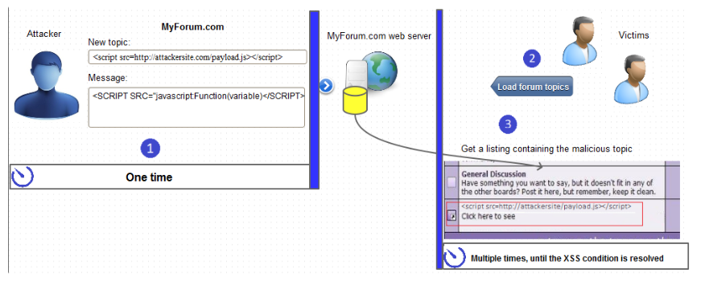
Forum XSS Example
An attacker identifies a forum as vulnerable.
They start a new topic and insert malicious scripts (<script></script>) in the topic title or body.
They can also tag the topic using popular keywords so that the topic is a popular search result.
The content of the forum post is stored by the server.
When victims browse topics or search for certain keywords, they may reach the infected topic.
When the topic loads, its content is sent to the victim’s browser and the payload is executed.

Slide 15
Cross-Site Scripting Attacks (XSS)
PREVENTION METHODS:
Ensure that any user inputs filter out code inputs, such as HTML and JavaScript.
< />
Quotes (‘) (“)
Regularly scan for any web application vulnerabilities and patch them accordingly.
Update website and server software to prevent future exploitation of vulnerabilities that may be targeted through an XSS attack.
Particularly important if you are using open-source software.

Slide 16
Cross-Site Request Forgery (CSRF)
WHAT: a Cross-Site Request Forgery (CSRF) attack is when a victim is forced to perform an unintended action on a web application they are logged into.
The web application will have already deemed the victim and their browser trustworthy, and so executes an action intended by the hacker when the victim is tricked into submitting a malicious request to the application.
Attackers typically use social engineering schemes (e.g. emails, text messages) to trick users into executing these attacks.
POTENTIAL NEGATIVE OUTCOMES:
Identify spoofing.
Illicit money transfers.
Compromise the entire web application if the targeted user is an administrator.

Slide 17
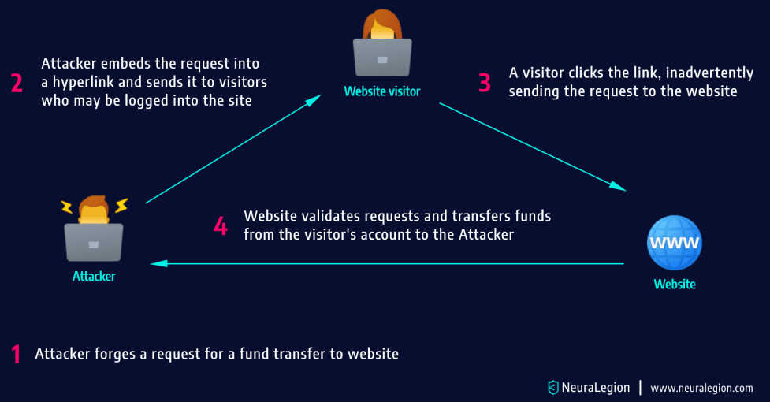
Attackers typically follow this process:
They use social engineering techniques to persuade the victim to click a link.
Either the malicious link itself, or a web page the user visits, triggers a request to the targeted site.
The request supposedly comes from the user and takes advantage of the fact that the user is already signed into the website.
The website acknowledges the request and performs the attacker’s requested action, without the user’s knowledge or consent.

Slide 18
Cross-Site Request Forgery (CSRF)
CSRF Attack Example
Assume the following GET request for a $5,000 bank transfer to account 12345:
GET https://somebank.com/transfer?account=12345&amount=5000
An attacker can create a script that will result in a transfer to their personal account (67890):
GET https://somebank.com/transfer?account=67890&amount=5000
The attacker can embed the request into a harmless-looking hyperlink:
<a href="https://somebank.com/transfer?account=67890&amount=5000">Click here for more funny cat videos!</a>
The attacker can distribute the hyperlink via email to a massive number of bank clients. Those who are already logged into their bank account and click on this link will unintentionally initiate the $5,000 transfer.

Slide 19
Cross-Site Request Forgery (CSRF)
CSRF Attack Example
If the bank’s website is only using POST requests, hyperlinks won’t work. Instead, the attack can be delivered in a self-submitting <form> tag:
<body onload="document.forms[0].submit()>
<form id=”csrf” action="https://somebank.com/transfer" method="POST">
<input type="hidden" name="account" value=“67890"/>
<input type="hidden" name="amount" value="5000"/>
</form>
</body>

Slide 20
Cross-Site Request Forgery (CSRF)
PREVENTION METHODS:
Regular scanning and testing the security of your web applications.
Implement advanced validation techniques.
Add an additional parameter with an additional value that the attacker is unaware of, but the server requires for validation. Known as an anti-CSRF token, or synchronizer token.
Implement mechanisms that require user intervention.
CAPTCHA
Use “SameSite” cookies.
Type of cookie that is only sent with requests to the same origin as the cookie's creation.

Slide 21
Best Practices for Developing Secure Web Applications
Do not trust user input!
Consider all user input to be hostile until proven otherwise.
Conduct proper input validation before passing it on.
Encrypt sensitive data.
Use proper exception management.
Don’t display system messages that normal users can’t understand, and hackers would find valuable.
Handle all errors appropriately and intelligently.
Implement appropriate authentication, role management, and access control mechanisms.
Strong password enforcement and secure password recovery mechanisms.
Multi-factor authentication.
Give every user as minimal privileges as possible for them to perform their tasks.

Slide 22
Best Practices for Developing Secure Web Applications
Maintain proper security configurations.
Keep software and libraries up-to-date.
Keep digital certificates up-to-date.
Remove default accounts and configurations from the webserver.
Implement HTTPS (Hypertext Transfer Protocol Secure).
HTTPS is a secure version of the HTTP protocol that uses the SSL/TLS protocol for encryption and authentication.
SSL is a technology used to establish an encrypted link between a web server and a browser. This ensures that the information passed between the browser and the web server remains private.
Implement auditing and logging at the server level.
Consider these best practices throughout the entire development lifecycle!

Slide 23
Session Management

Slide 24
Web Sessions
A web session is a series of contiguous actions by a visitor on an individual website within a given time frame.
“Session” is the term used to refer to a visitor’s time browsing a web site. It’s meant to represent the time between a visitor’s first arrival at a page on the site and the time they stop using the site.
Any interaction that you have with a website is recorded as a web session to that website property.
We can use sessions to provide a personalized experience for each user.
Remembering a user’s preferred language and currency.
Keeping a shopper’s items in their cart.

Slide 25
How Web Sessions Work
The server of a web application typically initiates a session when a user logs into a website. A session is identified by a unique session ID generated by the server.
The user's browser is given the session ID upon beginning a new session, and the session ID is exchanged during each subsequent communication between the browser and the server.
The session ID is passed as a parameter in URLs or stored in cookies.
The session ID allows the server to associate the user’s requests with their specific session. It helps to retrieve and update the session data as needed.
The session remains active until the user logs out or the session times out.
For example, web sessions in Google Analytics expire after 30 minutes of inactivity.

Slide 26
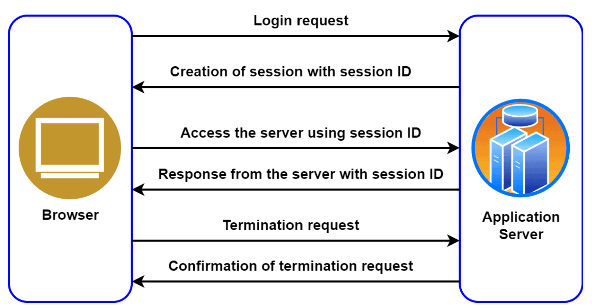
How Web Sessions Work

Slide 27
Sessions vs. Cookies
While both cookies and web sessions store information about users, their functions are different.
Cookies
Used to store long-term user information that should be preserved (e.g. automatically log the user in when arriving at a website).
Stored as text files on the user’s machine.
Lifespan is measured in days, months or years.
Web sessions
Used to store short-term user information, generally the user’s most recent activities.
Stored on the server in temporary memory.
Lifespan is measured in minutes.
A web session is unique to a specific visit, while a cookie is unique to a specific visitor.

Slide 28
Web Sessions in Node.js
To enable web sessions in Node.js, use the “express-session” module. It creates session middleware that your app can use to manage user sessions.
The session middleware handles all session-related tasks:
Creating the session.
Setting the session cookie.
Creating the session object in the req object.
Whenever the server receives a request from the same client, the server will have their session information stored on the server (assuming the server was not restarted).
We can add whatever properties we want to the session object.
[Demo of how to use the ‘express-session’ module and store a session variable.]

Slide 29
Authentication and Authorization

Slide 30
Authentication and Authorization
Every time you log onto a web application, you must go through authentication and authorization. The technologies for doing this can be quite complex, but they all have the same goal – to establish your identity and grant you appropriate access.
Authentication is the process of verifying who a user is.
Example: checking your ID before boarding a plane.
Authorization is the process of verifying what they have access to.
Example: determining what section of the plane you will be seated in (business or economy) and your specific seat number.

Slide 31
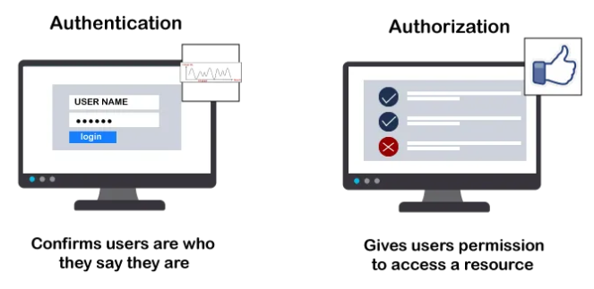
Authentication and Authorization
Access to a resource is protected by both authentication and authorization.
If you can't prove your identity, you won't be allowed into a resource.
Even if you can prove your identity, if you are not authorized for that resource, you will still be denied access.

Slide 32
Authentication in Node.js
Authentication can be implemented through various methods:
Username and password
Physical device (multifactor authentication)
Security questions
Biometrics
Common authentication methods in Node.js:
Session-based (e.g. session ID and cookies)
Token-based (e.g. JSON Web Tokens)
Third-party access (e.g. Open Authorization (OAuth)). This is a delegation protocol that allows applications to access resources on behalf of users. Widely used for granting access to social media platforms.

Slide 33
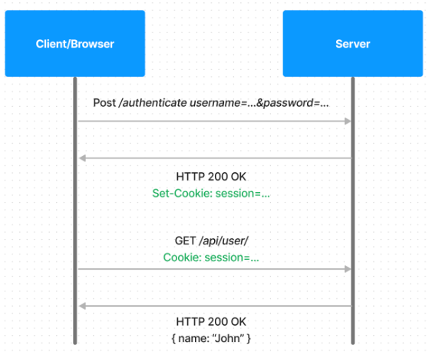
Authentication in Node.js
Session-based authentication:
The client browser sends a POST request for login credentials to the server.
The server then verifies the credentials, creates a session ID stored in the server, and returns it to the client to be stored in a cookie.
On subsequent requests by the client, the session ID from the cookie is verified in the server and the corresponding request is processed.
When the client logs out of the app, the session ID is cleared from both the client and server.

Slide 34
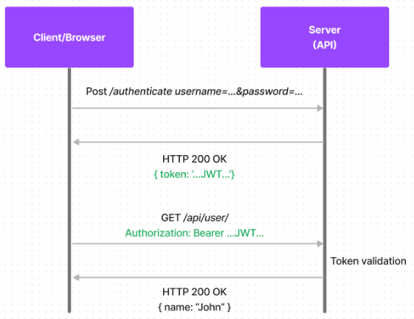
Authentication in Node.js
Token-based authentication:
JSON Web Tokens (JWTs) are a common method of implementing token-based authentication. It defines a self-contained way to transmit information as JSON objects securely.
The client browser sends a POST request for login credentials to the server.
The server validates these credentials and generates a signed JWT containing all the user’s information.
The token is stateless, so it never gets stored on the server.
Over the following requests, the token is passed to the server and gets decoded to verify it on the server.

Slide 35
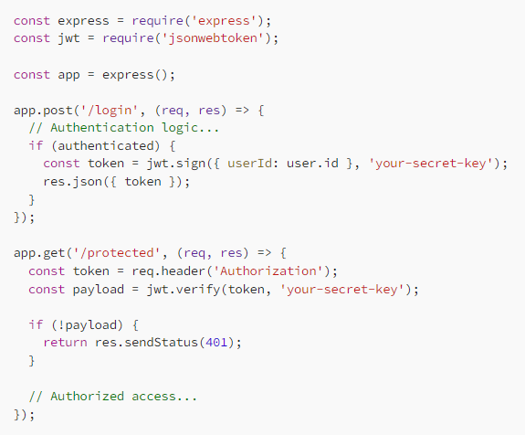
Authentication in Node.js
Example of token-based authentication in Node.js using JWT.

Slide 36
Authorization in Node.js
Authorization can be implemented in Node.js through various methods.
Role-Based Access Control (RBAC)
Define specific user roles such as “admin”, “editor”, and “user”.
Assign permissions to each role based on what they can and cannot do.
Give all users at least one of the available roles.
Implement middleware to check a user's role and permissions before allowing access to certain routes or resources. Use Node.js libraries like “express-jwt” or “passport” for token-based authentication and authorization.

Slide 37
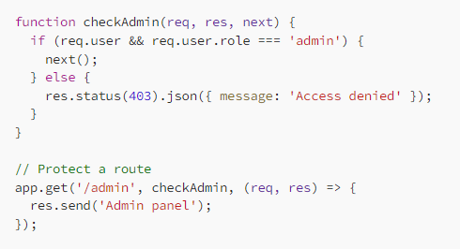
Authorization in Node.js
Example of role-based authorization using middleware in Express.js.

Slide 38
Group Project Check-in
What did your team accomplish since our last check-in?
What will your team accomplish by the next check-in?

Slide 39
Teacher Evaluations
Teacher and course evaluations are now open.
Please send me constructive feedback.
Closes August 23.

Slide 40
For next class
Open office: come with any questions or issues you need help with.
Work on your outstanding assessments. Be ready for your presentation during class on August 22, 8:00am.
Assessments Reminder:
Assignment 2 due August 20, 8:00am.
Group Project due August 22, 11:59pm.
All assessment dates have been posted in D2L.
See the “Assignments Policy” for late submission procedures.

Slide 41
References 1
https://www.baeldung.com/cs/web-sessions
https://redisson.org/glossary/web-session.html
https://hazelcast.com/glossary/web-session/
https://medium.com/@zakiazizi1841992/express-js-session-explained-super-easy-with-example-908d8bc4bef9
https://www.tutorialspoint.com/expressjs/expressjs_sessions.htm
https://auth0.com/docs/get-started/identity-fundamentals/authentication-and-authorization
https://www.authgear.com/post/web-application-authentication-guide
https://dev.to/rowsanali/authentication-and-authorization-in-nodejs-a-comprehensive-guide-4jl6#
https://medium.com/@roysalins94/authentication-and-authorization-in-node-js-applications-0062559690d6
https://javascript.plainenglish.io/simplifying-authentication-and-authorization-in-node-js-building-secure-web-applications-a12c0f25b6c5

Slide 42
References 2
https://www.freecodecamp.org/news/security-vulnerabilities-explained-with-rivers-and-parties-9c08798289b9
https://youtu.be/VE6c57Tk5gM?si=TNELHcbjQNlGbuEP
https://www.codecademy.com/learn/seasp-defending-node-applications-from-sql-injection-xss-csrf-attacks/modules/seasp-preventing-sql-injection-attacks/cheatsheet
https://www.kaspersky.com/resource-center/definitions/what-is-a-cross-site-scripting-attack
https://brightsec.com/blog/xss-attack/
https://blog.hubspot.com/website/cross-site-scripting
https://www.acunetix.com/blog/articles/persistent-xss/
https://www.lrswebsolutions.com/Blog/Posts/32/Website-Security/11-Best-Practices-for-Developing-Secure-Web-Applications/blog-post/
https://brightsec.com/blog/cross-site-request-forgery-csrf/
https://www.rapid7.com/fundamentals/web-application-vulnerabilities/
https://www.stackhawk.com/blog/10-web-application-security-threats-and-how-to-mitigate-them/
https://www.scaler.com/topics/mysql-tutorial/mysql-injection/

